Slide 1
Computational Photonics
Seminar 6, June 14, 2024
Finite-Difference Time-Domain Method (FDTD)
• Implementation of the 1D and 3D version of the FDTD method
• Test by propagating a pulse in a homogeneous and inhomogeneous medium

Slide 2
Tasks
Implement the FDTD method in 1D and 3D versions (functions fdtd_1d and fdtd_3d)
Simulate the test problems:
Propagation of pulse through a homogeneous and inhomogeneous medium
Test the convergence and accuracy of obtained results vs. parameters dx and dt
Don’t forget to interpolate the fields to the same grid in 1D and 2D

Slide 3
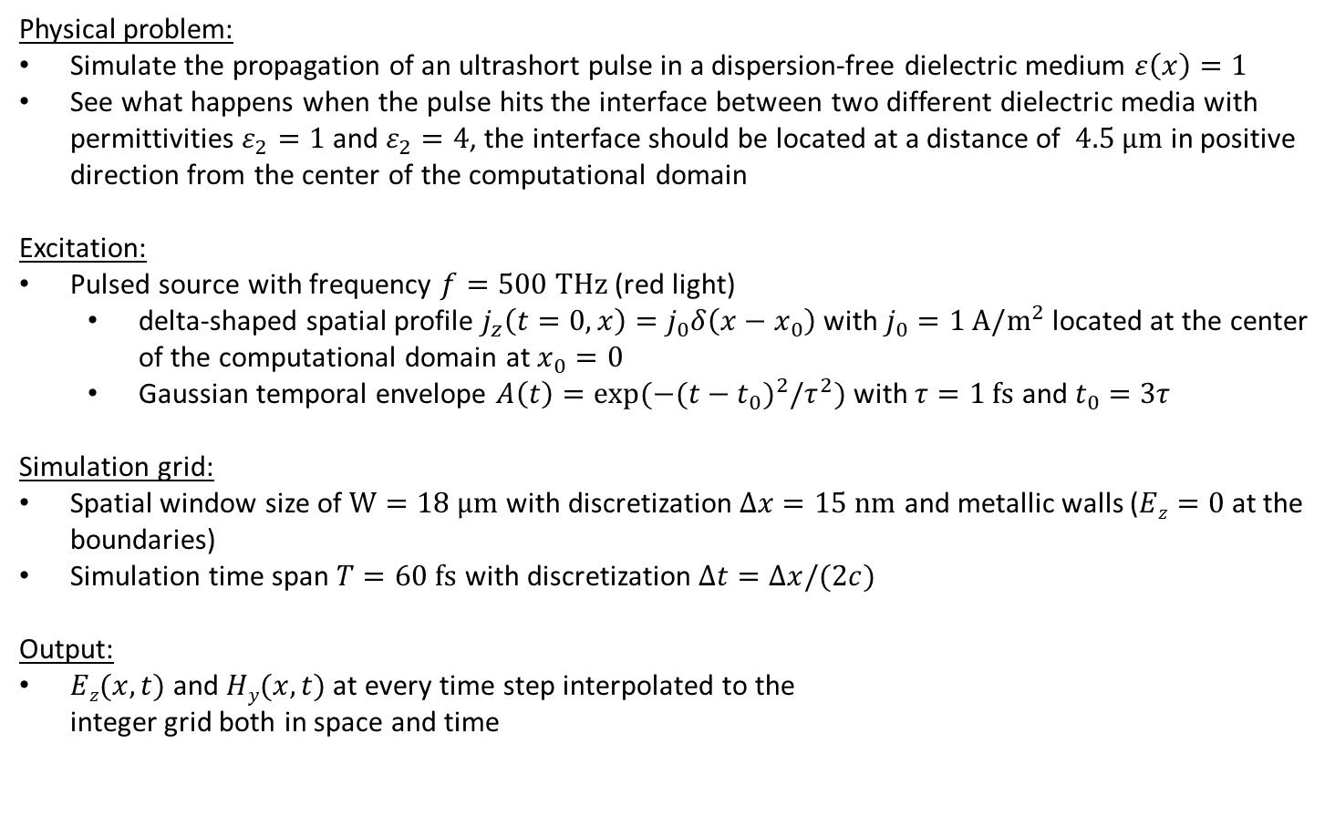
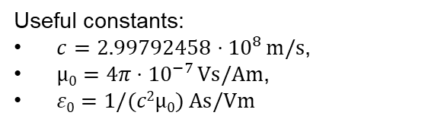
Task I: Implementation of the 1D FDTD method
Physical problem:
Simulate the propagation of an ultrashort pulse in a dispersion-free dielectric medium $ε\left(x\right)=1$
See what happens when the pulse hits the interface between two different dielectric media with permittivities $ε_{2}=1$ and $ε_{2}=4$, the interface should be located at a distance of $4.5 µm$ in positive direction from the center of the computational domain
Excitation:
Pulsed source with frequency $f=500 THz$ (red light)
delta-shaped spatial profile $j_{z}\left(t=0,x\right)=j_{0}δ\left(x−x_{0}\right)$ with $j_{0}=1 A/m^{2}$ located at the center of the computational domain at $x_{0}=0$
Gaussian temporal envelope $A\left(t\right)=\exp{(−{(t−t_{0})}^{2}/τ^{2})}$ with $τ=1 fs$ and $t_{0}=3τ$
Simulation grid:
Spatial window size of $W=18 µm$with discretization $Δx=15 nm$ and metallic walls ($Ez=0$ at the boundaries)
Simulation time span $T=60 fs$ with discretization $Δt=Δx/(2c)$
Output:
$Ez(x,t)$ and $Hy(x,t)$ at every time step interpolated to the integer grid both in space and time
Useful constants:
$c=2.99792458⋅{10}^{8} m/s$,
$µ0=4π⋅{10}^{−7} Vs/Am$,
$ε0=1/(c2µ0) As/Vm$
What effects do you see at the boundaries and what do you observe when the light crosses the interface? Explain those effects.

Slide 4
1D FDTD: Yee – Grid for E_{z} & H_{y} Components
Changing of index notation to integer indices
t(n)
t(n)
2.5
H
H
H
H
H
H
2
2
E
E
E
E
E
E
1.5
H
H
H
H
H
H
1
1
E
E
E
E
E
E
1
1.5
2
2.5
3
3.5
x(i)
1
2
3
x(i)
start at n=1:
start at n=1 (E¹=0, H¹=0) :
n+½ → n

Slide 5

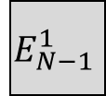

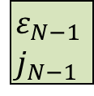
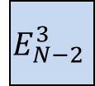
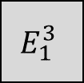
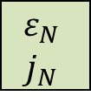
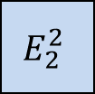
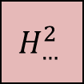
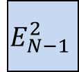
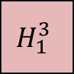
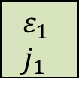


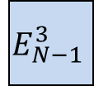
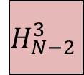
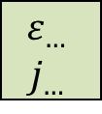
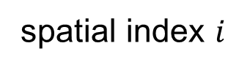

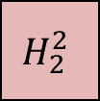

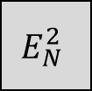
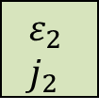
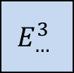


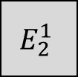
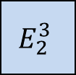
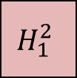
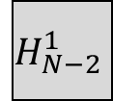

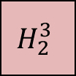
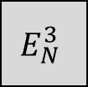
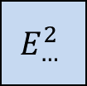

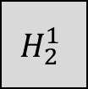




1D FDTD: Layout of the field arrays
boundary values
2.5
$$H_{1}^{3}$$
$$H_{2}^{3}$$
$$H$$
$$H_{N−2}^{3}$$
$$H_{N−1}^{3}$$
2
$$E_{1}^{3}$$
$$E_{2}^{3}$$
$$E_{…}^{3}$$
$$E_{N−2}^{3}$$
$$E_{N−1}^{3}$$
$$E_{N}^{3}$$
1.5
$$H_{1}^{2}$$
$$H_{2}^{2}$$
$$H_{…}^{2}$$
$$H_{N−2}^{2}$$
$$H_{N−1}^{2}$$
1
$$E_{1}^{2}$$
$$E_{2}^{2}$$
$$E_{…}^{2}$$
$$E_{N−2}^{2}$$
$$E_{N−1}^{2}$$
$$E_{N}^{2}$$
0.5
$$H_{1}^{1}$$
$$H_{2}^{1}$$
$$H_{…}^{1}$$
$$H_{N−2}^{1}$$
$$H_{N−1}^{1}$$
initial values
0
$$E_{1}^{1}$$
$$E_{2}^{1}$$
$$E_{…}^{1}$$
$$E_{N−2}^{1}$$
$$E_{N−1}^{1}$$
$$E_{N}^{1}$$
$$ε_{1} \\ j_{1}$$
$$ε_{2} \\ j_{2}$$
$$ε_{…}$$
$$j_{…}$$
$$ε_{N−2}$$
$$j_{N−2}$$
$$ε_{N−1}$$
$$j_{N−1}$$
$$ε_{N}$$
$$j_{N}$$
1
1.5
2
2.5
…
…
N-2
N-1.5
N-1
N-0.5
N
spatial index $i$

Slide 6
1D FDTD solution: time traces | homogeneous medium
Checking for physical consistency
Consistent transmission and reflection events for the field and energy flux.

Slide 7
1D FDTD solution: time traces | inhomogeneous medium
Checking for physical consistency
Reflection efficiency: 11.1%
Consistent transmission and reflection events for the field and energy flux.

Slide 8
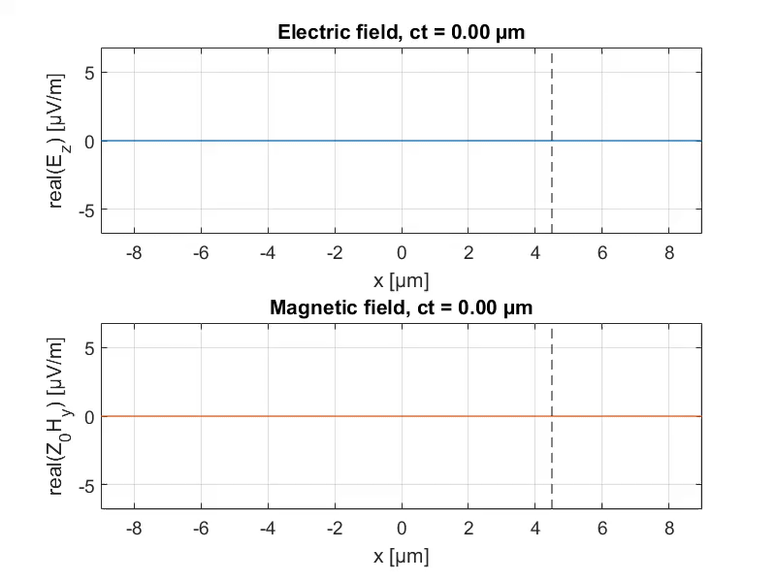
1D FDTD solution: field propagation

Slide 9
1D FDTD solution: summary
Implementation of the 1D-FDTD method was tested by simulating the propagation of electromagnetic fields in a homogeneous medium.
A separable current source was used for excitation, resulting in forward and backward traveling pulses with symmetric field profiles.
The short pulses exhibited some asymmetry during propagation due to limited spatial resolution, affecting high-frequency components.
The pulses remained unchanged in shape during propagation due to the absence of dispersion in the refractive index of the medium.
The power flow across the pulses was consistent with the propagation direction.
The tangential electric field changed its sign at the boundaries, while the magnetic field did not change sign.

Slide 10
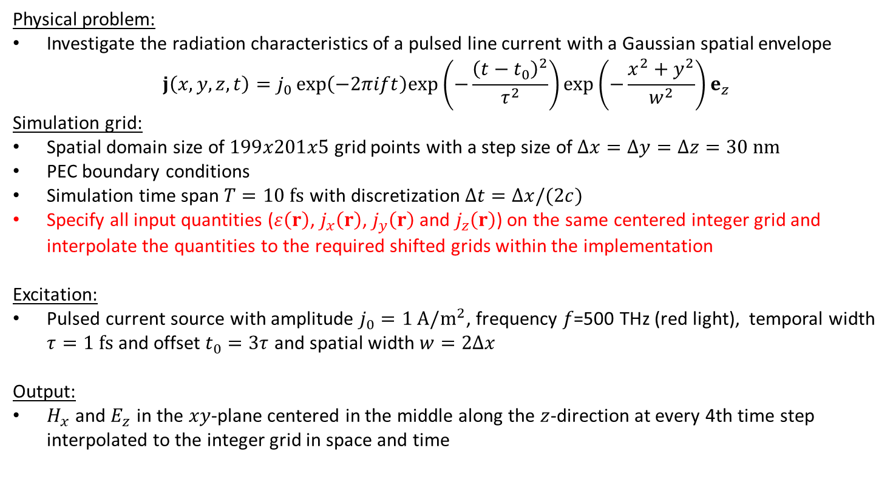
Task II: Implementation of the 3D FDTD method
Physical problem:
Investigate the radiation characteristics of a pulsed line current with a Gaussian spatial envelope $j\left(x,y,z,t\right)=j_{0}\exp\left(−2πift\right)exp⁡\left(−\frac{{\left(t−t_{0}\right)}^{2}}{τ^{2}}\right)\exp\left(−\frac{x^{2}+y^{2}}{w^{2}}\right)e_{z}$
Simulation grid:
Spatial domain size of $199x201x5$ grid points with a step size of $Δx=Δy=Δz=30 nm$
PEC boundary conditions
Simulation time span $T=10 fs$ with discretization $Δt=Δx/(2c)$
Specify all input quantities ($ε\left(r\right)$, $j_{x}\left(r\right)$, $j_{y}\left(r\right)$ and $j_{z}\left(r\right)$) on the same centered integer grid and interpolate the quantities to the required shifted grids within the implementation
Excitation:
Pulsed current source with amplitude $j_{0}=1 A/m^{2}$, frequency 𝑓=500 THz (red light), temporal width $τ=1 fs$ and offset $t_{0}=3τ$ and spatial width $w=2Δx$
Output:
$H_{x}$ and $E_{z}$ in the $xy$-plane centered in the middle along the $z$-direction at every 4th time step interpolated to the integer grid in space and time

Slide 11

3D FDTD: Yee-Grid
Center of the cube is in the center of the coordinate system $(i,j,k)$
Grid size is determined by the permittivity distribution:
$$size\left(ε\right)=[N_{x},N_{y},N_{z}]$$

Slide 12
3D FDTD: Electric Field Components
Permittivity must be interpolated:

Slide 13
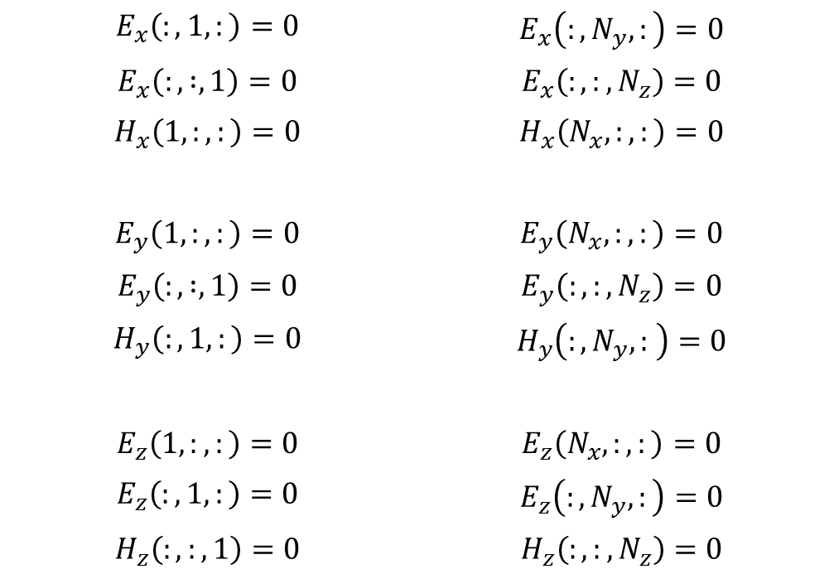
3D FDTD: Array Sizes and Boundary Conditions
PEC boundary conditions: At the boundaries the tangential E-fields and the normal H-fields are set to zero and are not updated
$$E_{x}\left(:,1,:\right)=0$$ | $$E_{x}\left(:,N_{y},:\right)=0$$
$$E_{x}\left(:, :,1\right)=0$$ | $$E_{x}\left(:,:,N_{z}\right)=0$$
$$H_{x}\left(1,:,:\right)=0$$ | $$H_{x}\left(N_{x},:,:\right)=0$$
$$E_{y}\left(1,:,:\right)=0$$ | $$E_{y}\left(N_{x},:,:\right)=0$$
$$E_{y}\left(:, :,1\right)=0$$ | $$E_{y}\left(:,:,N_{z}\right)=0$$
$$H_{y}\left(:, 1,:\right)=0$$ | $$H_{y}\left(:,N_{y},: \right)=0$$
$$E_{z}\left(1,:,:\right)=0$$ | $$E_{z}\left(N_{x},:,:\right)=0$$
$$E_{z}\left(:, 1,:\right)=0$$ | $$E_{z}\left(:,N_{y},:\right)=0$$
$$H_{z}\left(:,:,1\right)=0$$ | $$H_{z}\left(:,:,N_{z}\right)=0$$

Slide 14
3D FDTD: Time Stepping Update of the Electric Field
Separable source:
Tangential E-fields at boundary are not updated!

Slide 15
3D FDTD: Time Stepping Update of the Magnetic Field
Normal H-fields at boundary are not updated!

Slide 16
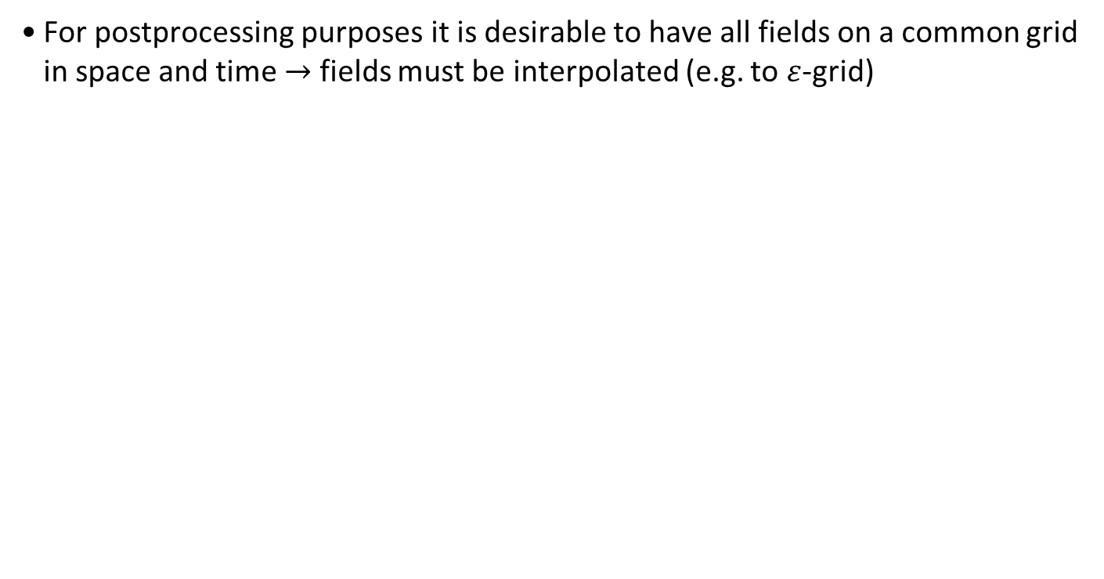
3D FDTD: Interpolation of Output
For postprocessing purposes it is desirable to have all fields on a common grid in space and time $→$ fields must be interpolated (e.g. to $ε$-grid)

Slide 17

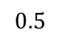



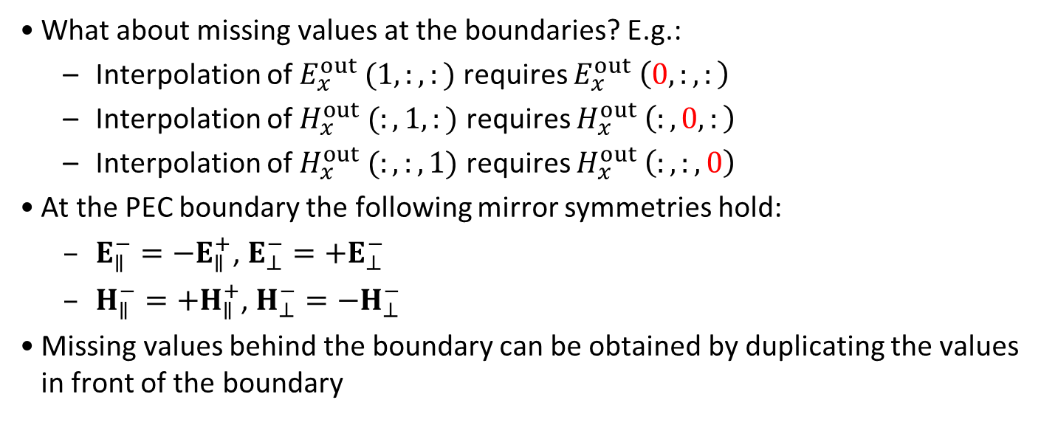

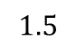




3D FDTD: Interpolation of Output
What about missing values at the boundaries? E.g.:
Interpolation of $E_{x}^{out} (1,:,:)$ requires $E_{x}^{out} \left(0,:,:\right)$
Interpolation of $H_{x}^{out} (:,1,:)$ requires $H_{x}^{out} \left(:,0,:\right)$
Interpolation of $H_{x}^{out} (:,:,1)$ requires $H_{x}^{out} \left(:,:,0\right)$
At the PEC boundary the following mirror symmetries hold:
$E_{∥}^{−}=−E_{∥}^{+}$, $E_{⊥}^{−}=+E_{⊥}^{−}$
$H_{∥}^{−}=+H_{∥}^{+}$, $H_{⊥}^{−}=−H_{⊥}^{−}$
Missing values behind the boundary can be obtained by duplicating the values in front of the boundary
$$E_{∥}^{+}$$
$$E_{⊥}^{+}$$
$$H_{∥}^{+}$$
$$H_{⊥}^{+}$$
Explain the physical reason for these mirror symmetries in your report
$$1.5$$
PEC
$$1$$
$$0.5$$
$$E_{∥}^{−}$$
$$E_{⊥}^{−}$$
$$H_{∥}^{−}$$
$$H_{⊥}^{−}$$

Slide 18
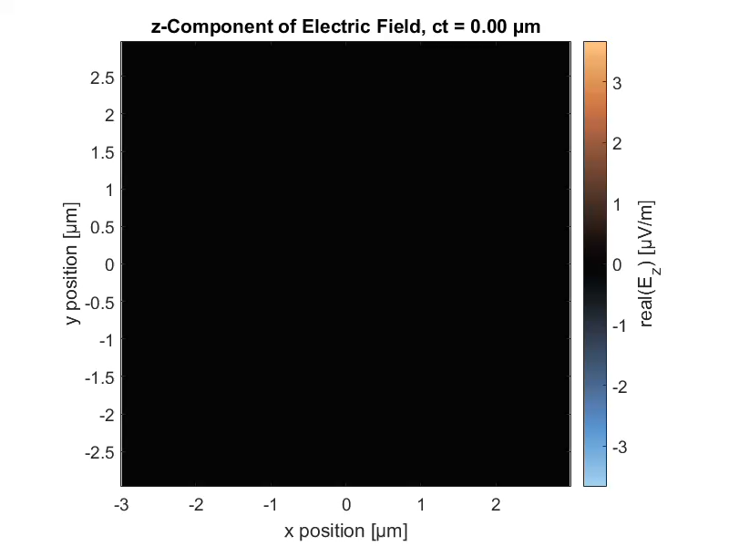

3D FDTD solution: videos of the E and H fields

Slide 19
3D FDTD solution: field maps after 15 fs
The magnetic field is 𝜑 polarized!

Slide 20
3D FDTD solution: summary
The 3D-FDTD method was tested by simulating the propagation of electromagnetic fields in a homogeneous medium with a refractive index of 𝑛 = 1.
A small extent of the computational grid with only 5 grid points along the 𝑧-direction was chosen to save memory, with a grid resolution set to Δ𝑟 = 30 nm.
A 𝑧-polarized line current with a Gaussian spatial profile along 𝑥 and 𝑦 was used for excitation, with the spatial width of the source being two grid points.
The temporal pulse parameters were the same as in the 1D test case, with a simulation duration of 𝑇 = 10 fs.
The magnetic field components were calculated based on the updated electric field components at each time step.
The magnetic field was found to be 𝜑-polarized, tangential to concentric circles centered at the source position.

